Slide 1
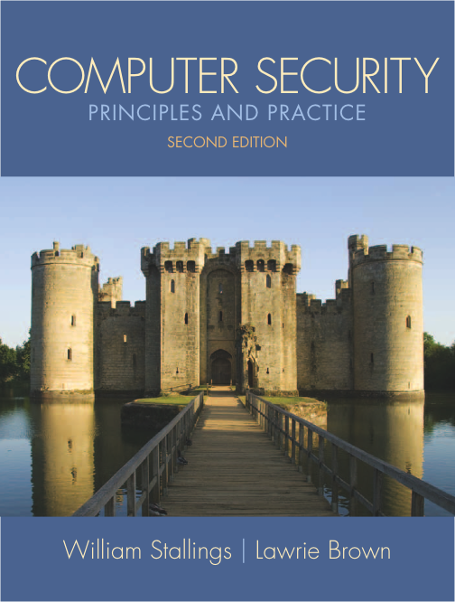
Notes:
Lecture slides prepared for “Computer Security: Principles and Practice”, 2/e, by William Stallings and Lawrie Brown, Chapter 1 “Overview”.

Slide 2

Chapter 1
Overview
Notes:
This chapter provides an overview of computer security. We begin with a discussion
of what we mean by computer security. In essence, computer security deals
with computer-related assets that are subject to a variety of threats and for which
various measures are taken to protect those assets. Accordingly, the next section
of this chapter provides a brief overview of the categories of computer-related
assets that users and system managers wish to preserve and protect, and a look at
the various threats and attacks that can be made on those assets. Then, we survey
the measures that can be taken to deal with such threats and attacks. This we do
from three different viewpoints, in Sections 1.3 through 1.5 . We then look at some
recent trends in computer security and lay out in general terms a computer security
strategy.
The focus of this chapter, and indeed this book, is on three fundamental
questions:
1. What assets do we need to protect?
2. How are those assets threatened?
3. What can we do to counter those threats?

Slide 3
Computer Security Overview
The NIST Computer Security Handbook defines the term Computer Security as:
“The protection afforded to an automated information system in order to attain the applicable objectives of preserving the integrity, availability and confidentiality of information system resources” (includes hardware, software, firmware, information/data, and telecommunications).
Notes:
The NIST Computer Security Handbook [NIST95] defines the term computer security
as follows:
Computer Security: The protection afforded to an automated information
system in order to attain the applicable objectives of preserving the integrity,
availability, and confidentiality of information system resources (includes hardware,
software, firmware, information/data, and telecommunications).
This definition introduces three key objectives that are at the heart of computer
security:
• Confidentiality: This term covers two related concepts:
— Data confidentiality : 1 Assures that private or confidential information is
not made available or disclosed to unauthorized individuals.
— Privacy : Assures that individuals control or influence what information
related to them may be collected and stored and by whom and to whom
that information may be disclosed.
• Integrity: This term covers two related concepts:
— Data integrity : Assures that information and programs are changed only
in a specified and authorized manner.
— System integrity : Assures that a system performs its intended function in
an unimpaired manner, free from deliberate or inadvertent unauthorized
manipulation of the system.
• Availability: Assures that systems work promptly and service is not denied to
authorized users.

Slide 4
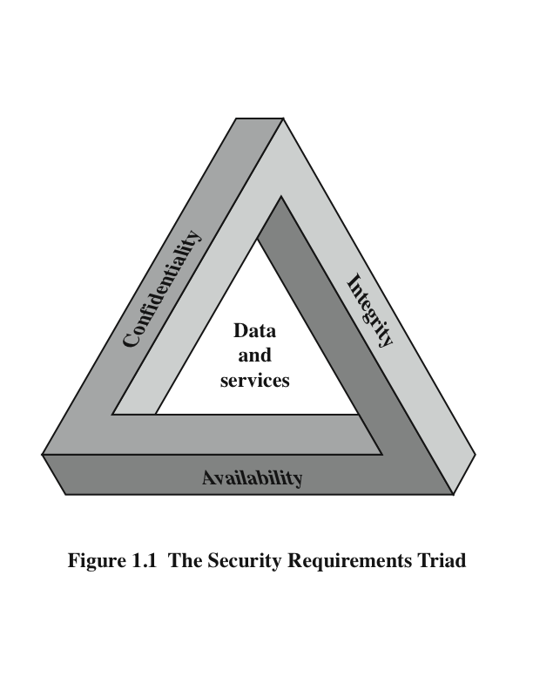
The CIA Triad
Confidentiality
data confidentiality
privacy
Integrity
- data integrity
- system integrity
Availability
Notes:
These three concepts form what is often referred to as the CIA triad
( Figure 1.1 ). The three concepts embody the fundamental security objectives for
both data and for information and computing services.
For example, the NIST standard FIPS 199 ( Standards for Security Categorization of Federal Information
and Information Systems ) lists confidentiality, integrity, and availability as the three
security objectives for information and for information systems.

Slide 5
Key Security Concepts
Confidentiality
preserving authorized restrictions on information access and disclosure, including means for protecting personal privacy and proprietary information
Integrity
guarding against improper information modification or destruction, including ensuring information nonrepudiation and authenticity
Availability
ensuring timely and reliable access to and use of information
Notes:
FIPS PUB 199
provides a useful characterization of these three objectives in terms of requirements
and the definition of a loss of security in each category:
• Confidentiality: Preserving authorized restrictions on information access
and disclosure, including means for protecting personal privacy and proprietary
information. A loss of confidentiality is the unauthorized disclosure of
information.
• Integrity: Guarding against improper information modification or destruction,
including ensuring information non-repudiation and authenticity. A loss of
integrity is the unauthorized modification or destruction of information.
• Availability: Ensuring timely and reliable access to and use of information.
A loss of availability is the disruption of access to or use of information or an
information system.
Although the use of the CIA triad to define security objectives is well established,
some in the security field feel that additional concepts are needed to present
a complete picture. Two of the most commonly mentioned are as follows:
• Authenticity: The property of being genuine and being able to be verified and
trusted; confidence in the validity of a transmission, a message, or message
originator. This means verifying that users are who they say they are and that
each input arriving at the system came from a trusted source.
• Accountability: The security goal that generates the requirement for actions
of an entity to be traced uniquely to that entity. This supports nonrepudiation,
deterrence, fault isolation, intrusion detection and prevention, and after-action
recovery and legal action. Because truly secure systems aren’t yet an achievable
goal, we must be able to trace a security breach to a responsible party. Systems
must keep records of their activities to permit later forensic analysis to trace
security breaches or to aid in transaction disputes.
Note that FIPS PUB 199 includes authenticity under integrity.

Slide 6
Computer Security Challenges
computer security is not as simple as it might first appear to the novice
potential attacks on the security features must be considered
procedures used to provide particular services are often counterintuitive
physical and logical placement needs to be determined
additional algorithms or protocols may be involved
attackers only need to find a single weakness, the developer needs to find all weaknesses
users and system managers tend to not see the benefits of security until a failure occurs
security requires regular and constant monitoring
is often an afterthought to be incorporated into a system after the design is complete
thought of as an impediment to efficient and user-friendly operation
Notes:
Computer security is both fascinating and complex. Some of the reasons follow:
1. Computer security is not as simple as it might first appear to the novice. The requirements seem to be straightforward, but the mechanisms used to meet those requirements can be quite complex and subtle.
2. In developing a particular security mechanism or algorithm, one must always consider potential attacks (often unexpected) on those security features.
3. Hence procedures used to provide particular services are often counterintuitive.
4. Having designed various security mechanisms, it is necessary to decide where to use them.
5. Security mechanisms typically involve more than a particular algorithm or protocol, but also require participants to have secret information, leading to issues of creation, distribution, and protection of that secret information.
6. Computer security is essentially a battle of wits between a perpetrator who tries to find holes and the designer or administrator who tries to close them.
7. There is a natural tendency on the part of users and system managers to perceive little benefit from security investment until a security failure occurs.
8. Security requires regular monitoring, difficult in today's short-term environment.
9. Security is still too often an afterthought - incorporated after the design is complete.
10. Many users / security administrators view strong security as an impediment to efficient and user-friendly operation of an information system or use of information.

Slide 7
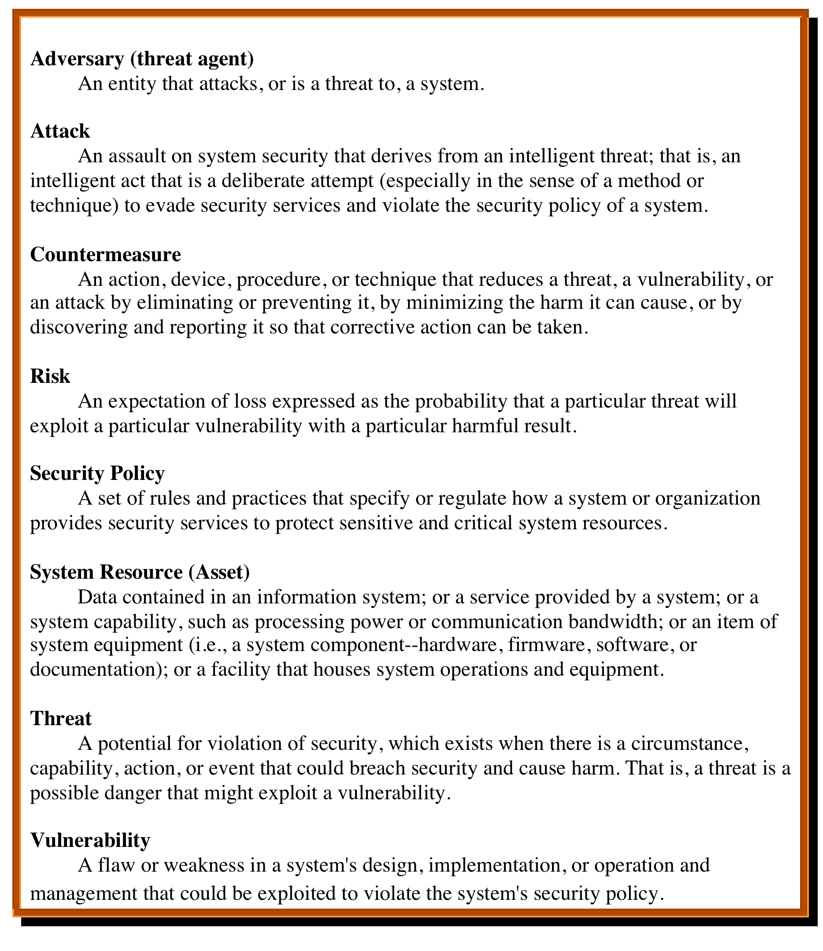
Table 1.1 Computer Security Terminology RFC 2828, Internet Security Glossary, May 2000
Notes:
We now introduce some terminology that will be useful throughout the book, relying
on RFC 2828, Internet Security Glossary . 3 Table 1.1 defines terms and Figure 1.2
[CCPS09a] shows the relationship among some of these terms.

Slide 8
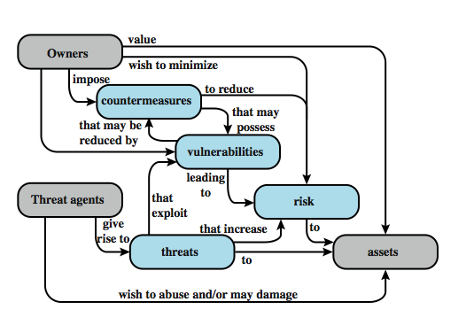

Figure 1.2 Security Concepts and Relationships
Notes:
Figure 1.2 [CCPS04a] shows the relationship among some terminology that will be useful throughout the book, drawn from RFC 2828, Internet Security Glossary:
Adversary (threat agent) - An entity that attacks, or is a threat to, a system.
Attack -An assault on system security that derives from an intelligent threat; a deliberate attempt to evade security services and violate security policy of a system.
Countermeasure - An action, device, procedure, or technique that reduces a threat, a vulnerability, or an attack by eliminating or preventing it, by minimizing the harm it can cause, or by discovering and reporting it so that corrective action can be taken.
Risk - An expectation of loss expressed as the probability that a particular threat will exploit a particular vulnerability with a particular harmful result.
Security Policy - A set of rules and practices that specify how a system or org provides security services to protect sensitive and critical system resources.
System Resource (Asset) - Data; a service provided by a system; a system capability; an item of system equipment; a facility that houses system operations and equipment.
Threat - A potential for violation of security, which exists when there is a circumstance, capability, action, or event that could breach security and cause harm.
Vulnerability - Flaw or weakness in a system's design, implementation, or operation and management that could be exploited to violate the system's security policy.

Slide 9
Vulnerabilities, Threats and Attacks
categories of vulnerabilities
corrupted (loss of integrity)
leaky (loss of confidentiality)
unavailable or very slow (loss of availability)
threats
capable of exploiting vulnerabilities
represent potential security harm to an asset
attacks (threats carried out)
passive – does not affect system resources
active – attempt to alter system resources or affect their operation
insider – initiated by an entity inside the security parameter
outsider – initiated from outside the perimeter
Notes:
In the context of security, our concern is with the vulnerabilities of system
resources. [NRC02] lists the following general categories of vulnerabilities of a
computer system or network asset:
• It can be corrupted , so that it does the wrong thing or gives wrong answers.
For example, stored data values may differ from what they should be because
they have been improperly modified.
• It can become leaky . For example, someone who should not have access to
some or all of the information available through the network obtains such
access.
• It can become unavailable or very slow. That is, using the system or network
becomes impossible or impractical.
These three general types of vulnerability correspond to the concepts of integrity,
confidentiality, and availability, enumerated earlier in this section.
Corresponding to the various types of vulnerabilities to a system resource are
threats that are capable of exploiting those vulnerabilities. A threat represents a
potential security harm to an asset. An attack is a threat that is carried out (threat
action) and, if successful, leads to an undesirable violation of security, or threat
consequence. The agent carrying out the attack is referred to as an attacker, or
threat agent .
We can distinguish two types of attacks:
• Active attack: An attempt to alter system resources or affect their operation.
• Passive attack: An attempt to learn or make use of information from the
system that does not affect system resources.
We can also classify attacks based on the origin of the attack:
• Inside attack: Initiated by an entity inside the security perimeter (an “insider”).
The insider is authorized to access system resources but uses them in a way not
approved by those who granted the authorization.
• Outside attack: Initiated from outside the perimeter, by an unauthorized or
illegitimate user of the system (an “outsider”). On the Internet, potential
outside attackers range from amateur pranksters to organized criminals, international
terrorists, and hostile governments.

Slide 10
Countermeasures
means used to deal with security attacks
prevent
detect
recover
may introduce new vulnerabilities
residual vulnerabilities may remain
goal is to minimize residual level of risk to the assets
Notes:
Finally, a countermeasure is any means taken to deal with a security attack.
Ideally, a countermeasure can be devised to prevent a particular type of attack from
succeeding. When prevention is not possible, or fails in some instance, the goal is to
detect the attack and then recover from the effects of the attack. A countermeasure
may itself introduce new vulnerabilities. In any case, residual vulnerabilities
may remain after the imposition of countermeasures. Such vulnerabilities may be
exploited by threat agents representing a residual level of risk to the assets. Owners
will seek to minimize that risk given other constraints.

Slide 11
Table 1.2 Threat Consequences
Notes:
Table 1.2 , based on RFC 2828, describes four kinds of threat consequences and lists
the kinds of attacks that result in each consequence.
Unauthorized disclosure is a threat to confidentiality. The following types of
attacks can result in this threat consequence:
• Exposure: This can be deliberate, as when an insider intentionally releases
sensitive information, such as credit card numbers, to an outsider. It can also
be the result of a human, hardware, or software error, which results in an entity
gaining unauthorized knowledge of sensitive data. There have been numerous
instances of this, such as universities accidentally posting student confidential
information on the Web.
• Interception: Interception is a common attack in the context of communications.
On a shared local area network (LAN), such as a wireless LAN or a
broadcast Ethernet, any device attached to the LAN can receive a copy of
packets intended for another device. On the Internet, a determined hacker
can gain access to e-mail traffic and other data transfers. All of these situations
create the potential for unauthorized access to data.
• Inference: An example of inference is known as traffic analysis, in which an
adversary is able to gain information from observing the pattern of traffic on
a network, such as the amount of traffic between particular pairs of hosts on
the network. Another example is the inference of detailed information from
a database by a user who has only limited access; this is accomplished by
repeated queries whose combined results enable inference.
• Intrusion: An example of intrusion is an adversary gaining unauthorized
access to sensitive data by overcoming the system’s access control protections.
Deception is a threat to either system integrity or data integrity. The following
types of attacks can result in this threat consequence:
• Masquerade: One example of masquerade is an attempt by an unauthorized
user to gain access to a system by posing as an authorized user; this could
happen if the unauthorized user has learned another user’s logon ID and
password. Another example is malicious logic, such as a Trojan horse, that
appears to perform a useful or desirable function but actually gains unauthorized
access to system resources or tricks a user into executing other malicious
logic.
• Falsification: This refers to the altering or replacing of valid data or the introduction
of false data into a file or database. For example, a student may alter
his or her grades on a school database.
• Repudiation: In this case, a user either denies sending data or a user denies
receiving or possessing the data.
Disruption is a threat to availability or system integrity. The following types of
attacks can result in this threat consequence:
• Incapacitation: This is an attack on system availability. This could occur as a
result of physical destruction of or damage to system hardware. More typically,
malicious software, such as Trojan horses, viruses, or worms, could operate in
such a way as to disable a system or some of its services.
• Corruption: This is an attack on system integrity. Malicious software in this
context could operate in such a way that system resources or services function
in an unintended manner. Or a user could gain unauthorized access to a system
and modify some of its functions. An example of the latter is a user placing
backdoor logic in the system to provide subsequent access to a system and its
resources by other than the usual procedure.
Obstruction: One way to obstruct system operation is to interfere with communications
by disabling communication links or altering communication
control information. Another way is to overload the system by placing excess
burden on communication traffic or processing resources.
Usurpation is a threat to system integrity. The following types of attacks can
result in this threat consequence:
• Misappropriation: This can include theft of service. An example is a distributed
denial of service attack, when malicious software is installed on a number of hosts
to be used as platforms to launch traffic at a target host. In this case, the malicious
software makes unauthorized use of processor and operating system resources.
• Misuse: Misuse can occur by means of either malicious logic or a hacker that
has gained unauthorized access to a system. In either case, security functions
can be disabled or thwarted.

Slide 12
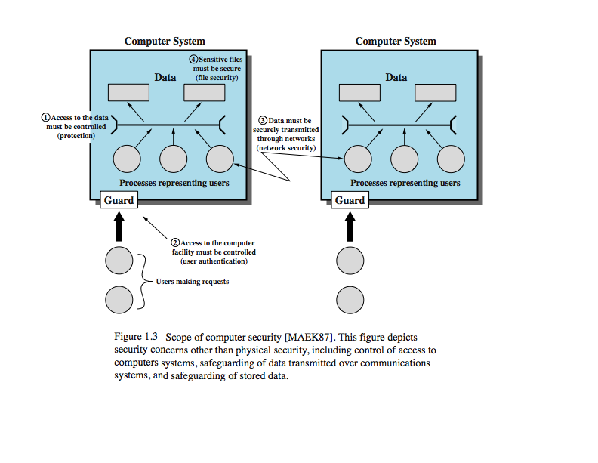
Figure 1.3 Scope of Computer Security
Notes:
The assets of a computer system can be categorized as hardware, software, data,
and communication lines and networks. In this subsection, we briefly describe these
four categories and relate these to the concepts of integrity, confidentiality, and
availability introduced in Section 1.1 (see Figure 1.3 and Table 1.3 ).

Slide 13
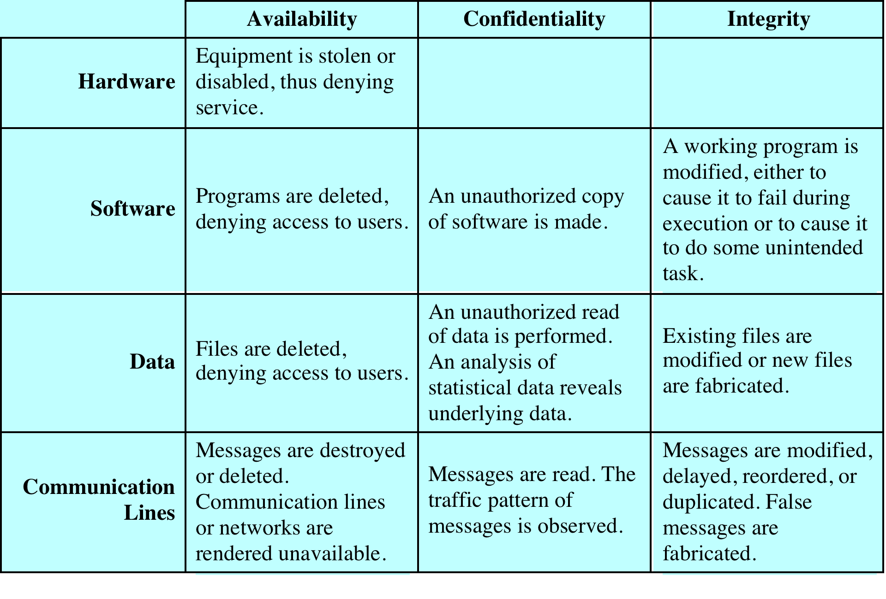
Table 1.3 Computer and Network Assets Examples of Threats
Table 1.3 Computer and Network Assets, with Examples of Threats.
Notes:
HARDWARE A major threat to computer system hardware is the threat to
availability. Hardware is the most vulnerable to attack and the least susceptible to
automated controls. Threats include accidental and deliberate damage to equipment
as well as theft. The proliferation of personal computers and workstations and the
widespread use of LANs increase the potential for losses in this area. Theft of
CD-ROMs and DVDs can lead to loss of confidentiality. Physical and administrative
security measures are needed to deal with these threats.
SOFTWARE Software includes the operating system, utilities, and application
programs. A key threat to software is an attack on availability. Software, especially
application software, is often easy to delete. Software can also be altered or
damaged to render it useless. Careful software configuration management, which
includes making backups of the most recent version of software, can maintain high
availability. A more difficult problem to deal with is software modification that
results in a program that still functions but that behaves differently than before,
which is a threat to integrity/authenticity. Computer viruses and related attacks fall
into this category. A final problem is protection against software piracy. Although
certain countermeasures are available, by and large the problem of unauthorized
copying of software has not been solved.
DATA Hardware and software security are typically concerns of computing center
professionals or individual concerns of personal computer users. A much more
widespread problem is data security, which involves files and other forms of data
controlled by individuals, groups, and business organizations.
Security concerns with respect to data are broad, encompassing availability,
secrecy, and integrity. In the case of availability, the concern is with the destruction
of data files, which can occur either accidentally or maliciously.
The obvious concern with secrecy is the unauthorized reading of data files or
databases, and this area has been the subject of perhaps more research and effort
than any other area of computer security. A less obvious threat to secrecy involves
the analysis of data and manifests itself in the use of so-called statistical databases,
which provide summary or aggregate information. Presumably, the existence of
aggregate information does not threaten the privacy of the individuals involved.
However, as the use of statistical databases grows, there is an increasing potential
for disclosure of personal information. In essence, characteristics of constituent
individuals may be identified through careful analysis. For example, if one table
records the aggregate of the incomes of respondents A, B, C, and D and another
records the aggregate of the incomes of A, B, C, D, and E, the difference between
the two aggregates would be the income of E. This problem is exacerbated by the
increasing desire to combine data sets. In many cases, matching several sets of data
for consistency at different levels of aggregation requires access to individual units.
Thus, the individual units, which are the subject of privacy concerns, are available at
various stages in the processing of data sets.
Finally, data integrity is a major concern in most installations. Modifications
to data files can have consequences ranging from minor to disastrous.

Slide 14
Passive and Active Attacks
Passive attacks attempt to learn or make use of information from the system but does not affect system resources
eavesdropping/monitoring transmissions
difficult to detect
emphasis is on prevention rather than detection
two types:
release of message contents
traffic analysis
Active attacks involve modification of the data stream
goal is to detect them and then recover
four categories:
masquerade
replay
modification of messages
denial of service
Notes:
COMMUNICATION LINES AND NETWORKS
Network security attacks can be classified
as passive attacks and active attacks . A passive attack attempts to learn or make
use of information from the system but does not affect system resources. An active
attack attempts to alter system resources or affect their operation.
Passive attacks are in the nature of eavesdropping on, or monitoring of,
transmissions. The goal of the attacker is to obtain information that is being transmitted.
Two types of passive attacks are release of message contents and traffic
analysis.
The release of message contents is easily understood. A telephone conversation,
an electronic mail message, and a transferred file may contain sensitive or
confidential information. We would like to prevent an opponent from learning the
contents of these transmissions.
A second type of passive attack, traffic analysis , is subtler. Suppose that we
had a way of masking the contents of messages or other information traffic so that
opponents, even if they captured the message, could not extract the information
from the message. The common technique for masking contents is encryption. If we
had encryption protection in place, an opponent might still be able to observe the
pattern of these messages. The opponent could determine the location and identity
of communicating hosts and could observe the frequency and length of messages
being exchanged. This information might be useful in guessing the nature of the
communication that was taking place.
Passive attacks are very difficult to detect because they do not involve any
alteration of the data. Typically, the message traffic is sent and received in an
apparently normal fashion and neither the sender nor receiver is aware that a
third party has read the messages or observed the traffic pattern. However, it is
feasible to prevent the success of these attacks, usually by means of encryption.
Thus, the emphasis in dealing with passive attacks is on prevention rather than
detection.
Active attacks involve some modification of the data stream or the creation
of a false stream and can be subdivided into four categories: replay, masquerade,
modification of messages, and denial of service.
Replay involves the passive capture of a data unit and its subsequent retransmission
to produce an unauthorized effect.
A masquerade takes place when one entity pretends to be a different entity. A
masquerade attack usually includes one of the other forms of active attack. For example,
authentication sequences can be captured and replayed after a valid authentication
sequence has taken place, thus enabling an authorized entity with few privileges
to obtain extra privileges by impersonating an entity that has those privileges.
Modification of messages simply means that some portion of a legitimate
message is altered, or that messages are delayed or reordered, to produce an
unauthorized effect. For example, a message stating, “Allow John Smith to read
confidential file accounts” is modified to say, “Allow Fred Brown to read confidential
file accounts.”
The denial of service prevents or inhibits the normal use or management of
communications facilities. This attack may have a specific target; for example, an
entity may suppress all messages directed to a particular destination (e.g., the security
audit service). Another form of service denial is the disruption of an entire network,
either by disabling the network or by overloading it with messages so as to degrade
performance.
Active attacks present the opposite characteristics of passive attacks. Whereas
passive attacks are difficult to detect, measures are available to prevent their
success. On the other hand, it is quite difficult to prevent active attacks absolutely,
because to do so would require physical protection of all communications facilities
and paths at all times. Instead, the goal is to detect them and to recover from any
disruption or delays caused by them. Because the detection has a deterrent effect, it
may also contribute to prevention.

Slide 15
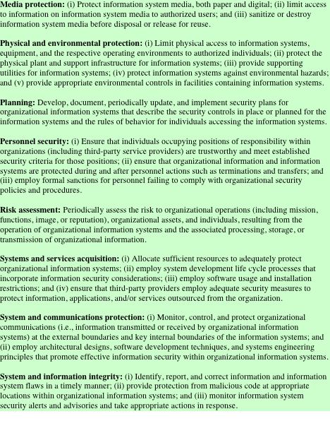
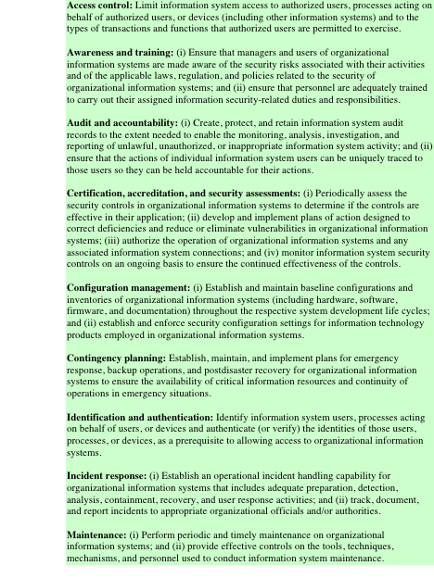
Security Requirements
Table 1.4
(FIPS PUB 200)
Notes:
There are a number of ways of classifying and characterizing the countermeasures
that may be used to reduce vulnerabilities and deal with threats to system assets. It
will be useful for the presentation in the remainder of the book to look at several
approaches, which we do in this and the next two sections. In this section, we view
countermeasures in terms of functional requirements, and we follow the classification
defined in FIPS PUB 200 ( Minimum Security Requirements for Federal Information
and Information Systems ). This standard enumerates 17 security-related areas with
regard to protecting the confidentiality, integrity, and availability of information
systems and the information processed, stored, and transmitted by those systems.
The areas are defined in Table 1.4 .
The requirements listed in FIP PUB 200 encompass a wide range of countermeasures
to security vulnerabilities and threats. Roughly, we can divide these
countermeasures into two categories: those that require computer security technical
measures (covered in this book in Parts One and Two), either hardware or
software, or both; and those that are fundamentally management issues (covered in
Part Three).

Slide 16
Security Functional Requirements
functional areas that primarily require computer security technical measures include:
access control; identification & authentication; system & communication protection; and system & information integrity
functional areas that primarily require management controls and procedures include:
awareness & training; audit & accountability; certification, accreditation, & security assessments; contingency planning; maintenance; physical & environmental protection; planning; personnel security; risk assessment; and systems & services acquisition
functional areas that overlap computer security technical measures and management controls include:
configuration management; incident response; and media protection
Notes:
Each of the functional areas may involve both computer security technical
measures and management measures. Functional areas that primarily require
computer security technical measures include access control, identification and
authentication, system and communication protection, and system and information
integrity. Functional areas that primarily involve management controls and procedures
include awareness and training; audit and accountability; certification, accreditation,
and security assessments; contingency planning; maintenance; physical and
environmental protection; planning; personnel security; risk assessment; and systems
and services acquisition. Functional areas that overlap computer security technical
measures and management controls include configuration management, incident
response, and media protection.
Note that the majority of the functional requirements areas in FIP PUB 200
are either primarily issues of management or at least have a significant management
component, as opposed to purely software or hardware solutions. This may be new
to some readers and is not reflected in many of the books on computer and information
security. But as one computer security expert observed, “If you think technology
can solve your security problems, then you don’t understand the problems and you
don’t understand the technology” [SCHN00]. This book reflects the need to combine
technical and managerial approaches to achieve effective computer security.
FIPS PUB 200 provides a useful summary of the principal areas of concern,
both technical and managerial, with respect to computer security. This book
attempts to cover all of these areas.

Slide 17
Security Architecture For Open Systems
ITU-T Recommendation X.800, Security Architecture for OSI
systematic way of defining the requirements for security and characterizing the approaches to satisfying them
was developed as an international standard
focuses on:
security attacks – action that compromises the security of information owned by an organization
security mechanism – designed to detect, prevent, or recover from a security attack
security service – intended to counter security attacks
Notes:
ITU-T Recommendation X.800, Security Architecture for OSI, defines a systematic way of defining the requirements for security and characterizing the approaches to satisfying those requirements. The OSI security architecture is useful to managers as a way of organizing the task of providing security. The OSI security architecture focuses on security attacks, mechanisms, and services. These can be defined briefly as:
• Security attack: Any action that compromises the security of information owned by an organization. cf. network security attacks slide earlier
• Security mechanism: A mechanism that is designed to detect, prevent, or recover from a security attack. cf. functional requirements from previous slide or Table 1.6 in text.
• Security service: A service that enhances the security of the data processing systems and the information transfers of an organization. The services are intended to counter security attacks, and they make use of one or more security mechanisms to provide the service. cf CIA security concepts earlier, or Table 1.5 in text.

Slide 18
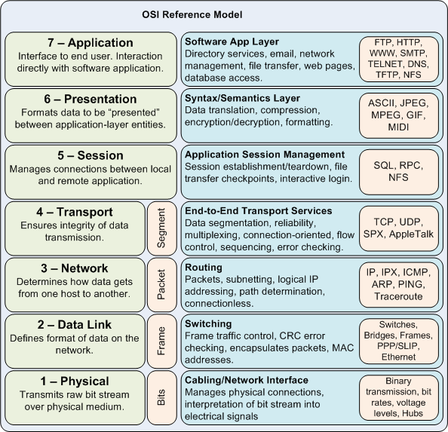
Notes:
GHK Note:
The Open Systems Interconnection model (OSI) is a conceptual model that characterizes and standardizes the internal functions of a communication system by partitioning it into abstraction layers. The model is a product of the Open Systems Interconnection project at the International Organization for Standardization (ISO), maintained by the identification ISO/IEC 7498-1

Slide 19
Security Services
X.800
RFC 2828
defines a security service as a service that is provided by a protocol layer of communicating open systems and ensures adequate security of the systems or of data transfers
defines a security service as a processing or communication service that is provided by a system to give a specific kind of protection to system resources; security services implement security policies and are implemented by security mechanisms
Notes:
X.800 defines a security service as a service that is provided by a protocol layer of
communicating open systems and that ensures adequate security of the systems or
of data transfers. Perhaps a clearer definition is found in RFC 2828, which provides
the following definition: a processing or communication service that is provided by
a system to give a specific kind of protection to system resources; security services
implement security policies and are implemented by security mechanisms.

Slide 20
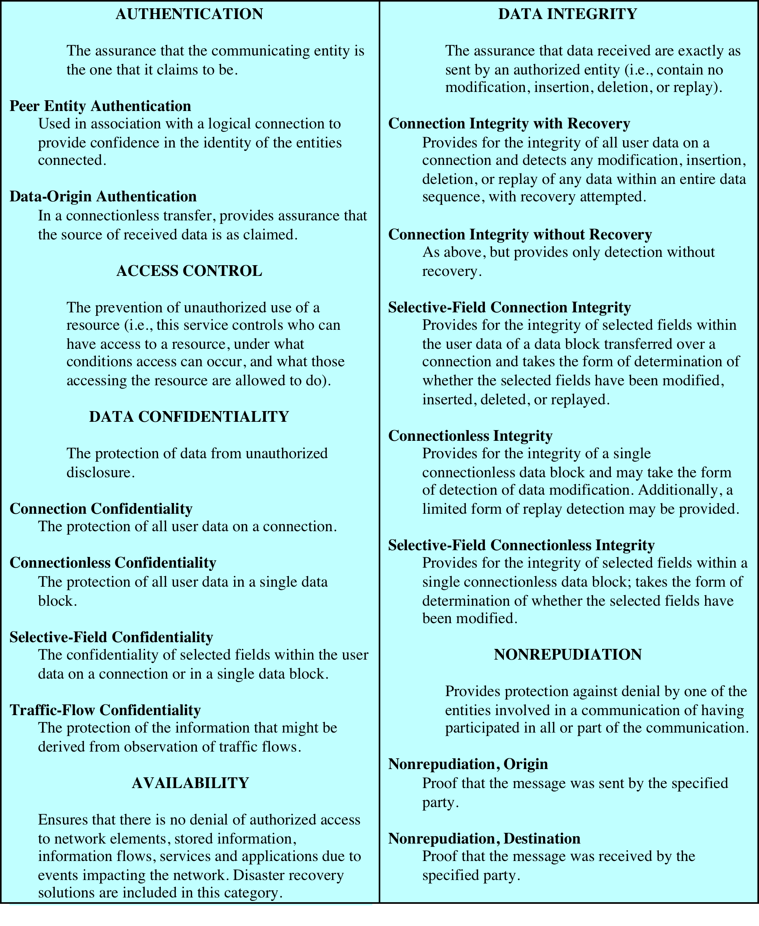
Table 1.5
Security
Services
Source: From X.800, Security Architecture for OSI
Notes:
X.800 divides these services into 6 categories and 14 specific services
( Table 1.5 ). We look at each category in turn. 5 Keep in mind that to a considerable
extent, X.800 is focused on distributed and networked systems and so emphasizes
network security over single-system computer security. Nevertheless, Table 1.5 is a
useful checklist of security services.

Slide 21
Data Origin Authentication
provides for the corroboration of the source of a data unit
does not provide protection against the duplication or modification of data units
this type of service supports applications like email where there are no prior interactions between the communicating entities
Authentication
Service
Peer Entity Authentication
provides for the corroboration of the identity of a peer entity in an association
provided for use at the establishment of, or at times during the data transfer phase of, a connection
attempts to provide confidence that an entity is not performing either a masquerade or an unauthorized replay of a previous connection
concerned with assuring that a communication is from the source that it claims to be from
must assure that the connection is not interfered with by a third party masquerading as one of the two legitimate parties
Notes:
AUTHENTICATION
The authentication service is concerned with assuring that a
communication is authentic. In the case of a single message, such as a warning or
alarm signal, the function of the authentication service is to assure the recipient that
the message is from the source that it claims to be from. In the case of an ongoing
interaction, such as the connection of a terminal to a host, two aspects are involved.
First, at the time of connection initiation, the service assures that the two entities are
authentic, that is, that each is the entity that it claims to be. Second, the service must
assure that the connection is not interfered with in such a way that a third party can
masquerade as one of the two legitimate parties for the purposes of unauthorized
transmission or reception.
Two specific authentication services are defined in the standard:
• Peer entity authentication: Provides for the corroboration of the identity
of a peer entity in an association. Two entities are considered peer if they
implement the same protocol in different systems (e.g., two TCP users in two
communicating systems). Peer entity authentication is provided for use at the
establishment of, or at times during the data transfer phase of, a connection. It
attempts to provide confidence that an entity is not performing either a masquerade
or an unauthorized replay of a previous connection.
• Data origin authentication: Provides for the corroboration of the source
of a data unit. It does not provide protection against the duplication or
modification of data units. This type of service supports applications like
electronic mail where there are no prior interactions between the communicating
entities.

Slide 22
Access Control
Service
Nonrepudiation
Service
prevents either sender or receiver from denying a transmitted message
receiver can prove that the alleged sender in fact sent the message
the sender can prove that the alleged receiver in fact received the message
the ability to limit and control the access to host systems and applications via communications links
each entity trying to gain access must first be identified, or authenticated, so that access rights can be tailored to the individual
Notes:
ACCESS CONTROL In the context of network security, access control is the ability
to limit and control the access to host systems and applications via communications
links. To achieve this, each entity trying to gain access must first be identified, or
authenticated, so that access rights can be tailored to the individual.
NONREPUDIATION prevents either sender or receiver from
denying a transmitted message. Thus, when a message is sent, the receiver can
prove that the alleged sender in fact sent the message. Similarly, when a message
is received, the sender can prove that the alleged receiver in fact received the
message.

Slide 23
protects the traffic flow from analysis
this requires that an attacker not be able to observe the source and destination, frequency, length, or other characteristics of the traffic on a communications facility
connectionless confidentiality
protection of all user data in a single data block
selective-field confidentiality
confidentiality of selected fields within the user data on a connection or a single data block
traffic-flow confidentiality
protection of the information that might be derived from observation of traffic flows
Data Confidentiality
Service
the protection of transmitted data from passive attacks
the broadest service protects all user data transmitted between two users over a period of time
connection confidentiality
the protection of all user data on a connection
Notes:
DATA CONFIDENTIALITY
In the context of network security, confidentiality
is the protection of transmitted data from passive attacks. With respect to the
content of a data transmission, several levels of protection can be identified. The
broadest service protects all user data transmitted between two users over a period
of time. For example, when a TCP connection is set up between two systems,
this broad protection prevents the release of any user data transmitted over the
TCP connection. Narrower forms of this service can also be defined, including
the protection of a single message or even specific fields within a message. These
refinements are less useful than the broad approach and may even be more complex
and expensive to implement.
The other aspect of confidentiality is the protection of traffic flow from
analysis. This requires that an attacker not be able to observe the source and
destination, frequency, length, or other characteristics of the traffic on a communications
facility.

Slide 24
a connection-oriented integrity service assures that messages are received as sent, with no duplication, insertion modification, reordering, or replays
destruction of data is also covered under this service
addresses both message stream modification and denial of service
need to make a distinction between the service with and without recovery
concerned with detection rather than prevention
the incorporation of automated recovery mechanisms is the more attractive alternative
Data
Integrity
Service
can apply to a stream of messages, a single message, or selected fields within a message
a connectionless integrity service generally provides protection against message modification only
Notes:
DATA INTEGRITY
In the context of network security, as with data confidentiality,
data integrity can apply to a stream of messages, a single message, or selected fields
within a message. Again, the most useful and straightforward approach is total
stream protection.
A connection-oriented integrity service, one that deals with a stream
of messages, assures that messages are received as sent, with no duplication,
insertion, modification, reordering, or replays. The destruction of data is also covered
under this service. Thus, the connection-oriented integrity service addresses
both message stream modification and denial of service. On the other hand, a
connectionless integrity service, one that deals with individual messages without
regard to any larger context, generally provides protection against message modification
only.
We need to make a distinction between the service with and without recovery.
Because the integrity service relates to active attacks, we are concerned with
detection rather than prevention. If a violation of integrity is detected, then the
service may simply report this violation, and some other portion of software or
human intervention is required to recover from the violation. Alternatively, there
are mechanisms available to recover from the loss of integrity of data, as we will
review subsequently. The incorporation of automated recovery mechanisms is, in
general, the more attractive alternative.

Slide 25
a variety of attacks can result in the loss of or reduction in availability
some of these attacks are amenable to authentication and encryption
some attacks require a physical action to prevent or recover from loss of availability
X.800 treats availability as a property to be associated with various security services
addresses the security concerns raised by denial-of-service attacks
depends on proper management and control of system resources
Availability
Service
a service that protects a system to ensure its availability
defined as the property of a system or a system resource being accessible and usable upon demand by an authorized system entity, according to performance specifications of the system
Notes:
AVAILABILITY
Both X.800 and RFC 2828 define availability to be the property
of a system or a system resource being accessible and usable upon demand by an
authorized system entity, according to performance specifications for the system (i.e.,
a system is available if it provides services according to the system design whenever
users request them). A variety of attacks can result in the loss of or reduction in
availability. Some of these attacks are amenable to automated countermeasures,
such as authentication and encryption, whereas others require a physical action to
prevent or recover from loss of availability.
X.800 treats availability as a property to be associated with various security
services. X.805, Security Architecture for Systems Providing End-to-End
Communications , refers specifically to an availability service. An availability service
is one that protects a system to ensure its availability. This service addresses the
security concerns raised by denial-of-service attacks. It depends on proper management
and control of system resources and thus depends on access control service
and other security services.

Slide 26
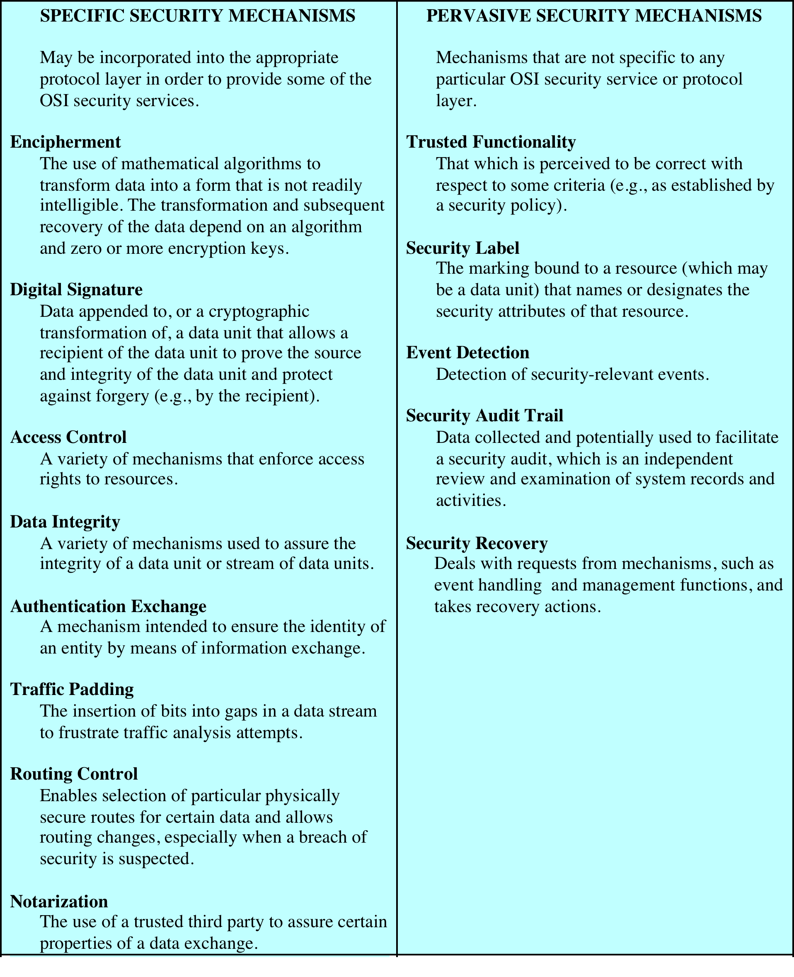
Table 1.6
X.800 Security
Mechanisms
Notes:
Security Mechanisms
Table 1.6 lists the security mechanisms defined in X.800. The mechanisms are
divided into those that are implemented in a specific protocol layer, such as TCP
or an application-layer protocol, and those that are not specific to any particular
protocol layer or security service. These mechanisms will be covered in the appropriate
places in the book and so we do not elaborate now, except to comment on the
definition of encipherment. X.800 distinguishes between reversible encipherment
mechanisms and irreversible encipherment mechanisms. A reversible encipherment
mechanism is an encryption algorithm that allows data to be encrypted and subsequently
decrypted. Irreversible encipherment mechanisms include hash algorithms
and message authentication codes, which are used in digital signature and message
authentication applications.

Slide 27
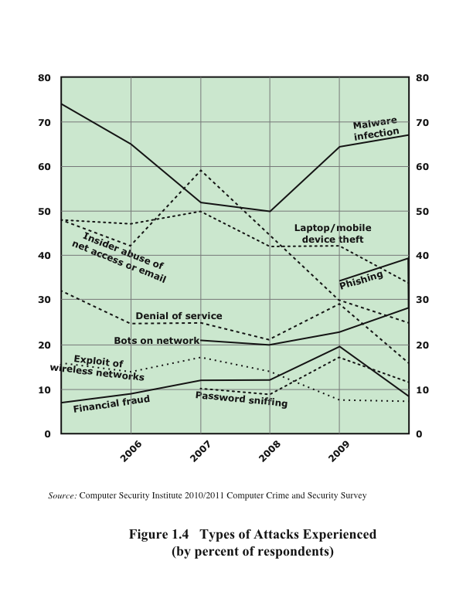
Figure 1.4 Security Trends
Notes:
In order to assess the relative severity of various threats and the relative importance
of various approaches to computer security, it is useful to look at the experience of
organizations. A useful view is provided by the CSI Computer Crime and Security
Survey for 2010/2011, conducted by the Computer Security Institute. The respondents
consisted of over 350 U.S.-based companies, nonprofit organizations, and
public sector organizations.
Figure 1.4 shows the types of attacks experienced by respondents in nine
major categories. 6 Most noteworthy is the large and growing prevalence of malicious
software (malware) attacks. It is also worth noting that most categories of
attack exhibit a somewhat downward trend. The CSI report speculates that this is
due in large part to improved security techniques by organizations.

Slide 28
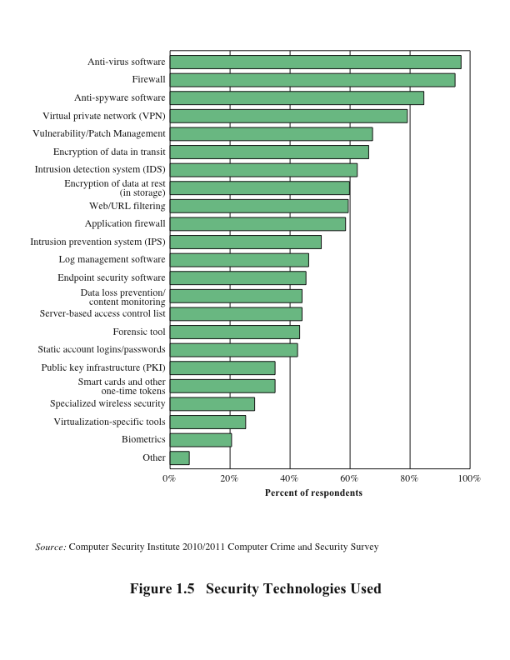
Figure 1.5 Security Technologies Used
Notes:
Figure 1.5 indicates the types of security technology used by organizations to
counter threats. Both firewalls and antivirus software are used almost universally.
This popularity reflects a number of factors:
• The maturity of these technologies means that security administrators are
very familiar with the products and are confident of their effectiveness.
• Because these technologies are mature and there are a number of vendors, costs
tend to be quite reasonable and user-friendly interfaces are available.
• The threats countered by these technologies are among the most significant
facing security administrators.

Slide 29
Computer Security Strategy
specification/policy
what is the security scheme supposed to do?
implementation/mechanisms
how does it do it?
correctness/assurance
does it really work?
Notes:
We conclude this chapter with a brief look at the overall strategy for providing
computer security. [LAMP04] suggests that a comprehensive security strategy
involves three aspects:
• Specification/policy: What is the security scheme supposed to do?
• Implementation/mechanisms: How does it do it?
• Correctness/assurance: Does it really work?

Slide 30
Security Policy
formal statement of rules and practices that specify or regulate how a system or organization provides security services to protect sensitive and critical system resources
factors to consider:
value of the assets being protected
vulnerabilities of the system
potential threats and the likelihood of attacks
trade-offs to consider:
ease of use versus security
cost of security versus cost of failure and recovery
Notes:
The first step in devising security services and mechanisms is to develop a security
policy. Those involved with computer security use the term security policy in
various ways. At the least, a security policy is an informal description of desired
system behavior [NRC91]. Such informal policies may reference requirements for
security, integrity, and availability. More usefully, a security policy is a formal statement
of rules and practices that specify or regulate how a system or organization
provides security services to protect sensitive and critical system resources (RFC
2828). Such a formal security policy lends itself to being enforced by the system’s
technical controls as well as its management and operational controls.
In developing a security policy, a security manager needs to consider the
following factors:
• The value of the assets being protected
• The vulnerabilities of the system
• Potential threats and the likelihood of attacks
Further, the manager must consider the following trade-offs:
• Ease of use versus security: Virtually all security measures involve some penalty
in the area of ease of use. The following are some examples. Access control
mechanisms require users to remember passwords and perhaps perform other
access control actions. Firewalls and other network security measures may
reduce available transmission capacity or slow response time. Virus-checking
software reduces available processing power and introduces the possibility of
system crashes or malfunctions due to improper interaction between the security
software and the operating system.
• Cost of security versus cost of failure and recovery: In addition to ease of use
and performance costs, there are direct monetary costs in implementing and
maintaining security measures. All of these costs must be balanced against the
cost of security failure and recovery if certain security measures are lacking.
The cost of security failure and recovery must take into account not only the
value of the assets being protected and the damages resulting from a security
violation, but also the risk, which is the probability that a particular threat will
exploit a particular vulnerability with a particular harmful result.
Security policy is thus a business decision, possibly influenced by legal requirements.

Slide 31
Security Implementation
involves four complementary courses of action:
prevention
secure encryption algorithms
prevent unauthorized access to encryption keys
detection
intrusion detection systems
detection of denial of service attacks
response
upon detection, being able to halt an attack and prevent further damage
prevention
secure encryption algorithms
prevent unauthorized access to encryption keys
detection
intrusion detection systems
detection of denial of service attacks
response
upon detection, being able to halt an attack and prevent further damage
recovery
use of backup systems
involves four complementary courses of action:
Notes:
Security implementation involves four complementary courses of action:
• Prevention: An ideal security scheme is one in which no attack is successful.
Although this is not practical in all cases, there is a wide range of threats in
which prevention is a reasonable goal. For example, consider the transmission
of encrypted data. If a secure encryption algorithm is used, and if measures
are in place to prevent unauthorized access to encryption keys, then attacks on
confidentiality of the transmitted data will be prevented.
• Detection: In a number of cases, absolute protection is not feasible, but it is
practical to detect security attacks. For example, there are intrusion detection
systems designed to detect the presence of unauthorized individuals logged
onto a system. Another example is detection of a denial of service attack, in
which communications or processing resources are consumed so that they are
unavailable to legitimate users.
• Response: If security mechanisms detect an ongoing attack, such as a denial of
service attack, the system may be able to respond in such a way as to halt the
attack and prevent further damage.
• Recovery: An example of recovery is the use of backup systems, so that if data
integrity is compromised, a prior, correct copy of the data can be reloaded.

Slide 32
Assurance and Evaluation
assurance
the degree of confidence one has that the security measures work as intended to protect the system and the information it processes
encompasses both system design and system implementation
evaluation
process of examining a computer product or system with respect to certain criteria
involves testing and formal analytic or mathematical techniques
Notes:
Those who are “consumers” of computer security services and mechanisms (e.g.,
system managers, vendors, customers, and end users) desire a belief that the security
measures in place work as intended. That is, security consumers want to feel that the
security infrastructure of their systems meet security requirements and enforce security
policies. These considerations bring us to the concepts of assurance and evaluation.
The NIST Computer Security Handbook [NIST95] defines assurance as the
degree of confidence one has that the security measures, both technical and operational,
work as intended to protect the system and the information it processes. This
encompasses both system design and system implementation. Thus, assurance deals
with the questions, “Does the security system design meet its requirements?” and
“Does the security system implementation meet its specifications?”
Note that assurance is expressed as a degree of confidence, not in terms of a formal
proof that a design or implementation is correct. With the present state of the art,
it is very difficult if not impossible to move beyond a degree of confidence to absolute
proof. Much work has been done in developing formal models that define requirements
and characterize designs and implementations, together with logical and mathematical
techniques for addressing these issues. But assurance is still a matter of degree.
Evaluation is the process of examining a computer product or system with
respect to certain criteria. Evaluation involves testing and may also involve formal
analytic or mathematical techniques. The central thrust of work in this area is
the development of evaluation criteria that can be applied to any security system
(encompassing security services and mechanisms) and that are broadly supported
for making product comparisons.

Slide 33
Summary
security concepts
CIA triad
confidentiality – preserving the disclosure of information
integrity – guarding against modification or destruction of information
availability – ensuring timely and reliable access to information
terminology – table 1.1
threats – exploits vulnerabilities
attack – a threat carried out
countermeasure – means to deal with a security attack
assets – hardware, software, data, communication lines, networks
security architecture
security services – enhances the security of systems and information transfers, table 1.5
security mechanisms – mechanisms designed to detect, prevent, or recover from a security attack, table 1.6
security attack – any action that compromises the security of information owned by an organization
security trends
figure 1.4
security strategy
policy, implementation, assurance and evaluation
functional requirements
table 1.4
Notes:
Chapter 1 summary.

